Slide 1
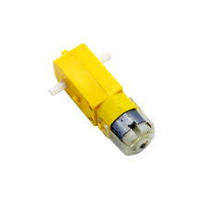
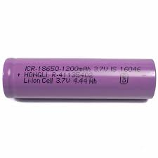
AKSD Market
Dual Shaft Gear DC Motor
Price – 60rs.
Operating Voltage – 3v to 12v.
Rechargeable Lithium Ion Cell
Price – 60rs.
Capacity – 1200mah
Output Voltage – 3.7v

Slide 2
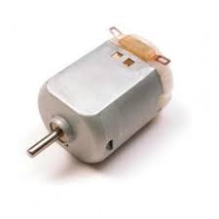
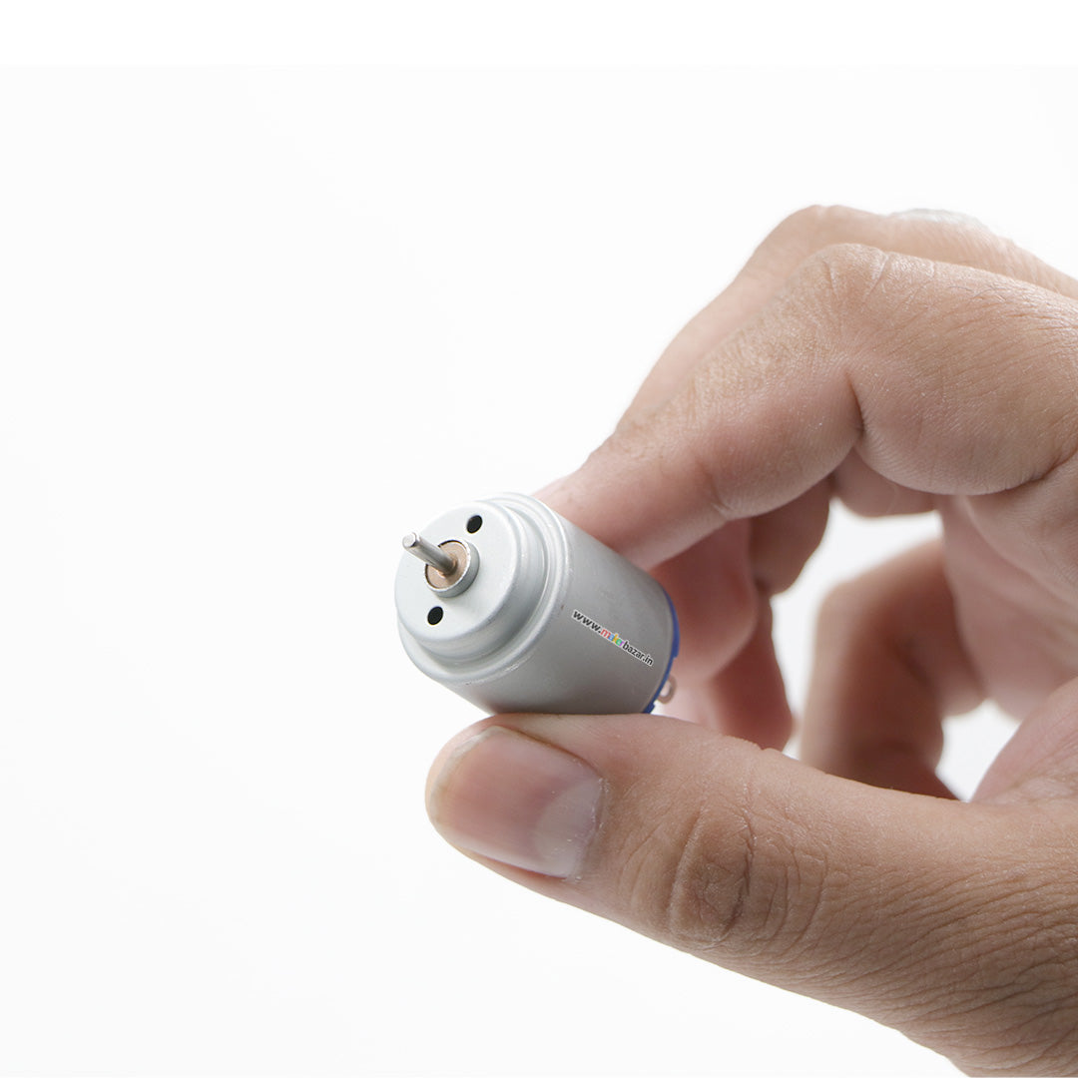
DC Motor
Price – 15rs.
Operating Voltage – 0.9v to 3v

